Slide 1
Ch 08. Feature Reduction and Selection
Part 1 Feature Reduction
Notes:
1

Slide 2
Error and Dimensionality
For example
Bayes error probability
As r goes up, the probability of error goes down
，
Suppose each feature is independent：
Mahalanobis distance from to
The introduction of new features can increase r and thus reduce the error probability

Slide 3
Curse of Dimensionality
In practical application
When the number of features increases to a certain critical point, the continuous increase will lead to the performance of the classifier becomes worse —“Curse of dimensionality”(维度灾难)
Reason
The hypothetical probabilistic model does not match the real model
Due to the limited number of training samples, the estimate of probability distribution is inaccurate
……
For high-dimensional data, "Curse of dimensionality" makes it very difficult to solve the problem of pattern recognition. At this time, it is often required to reduce the dimension of feature vectors first

Slide 4
Dimensionality Reduction
Feasibility of reducing eigenvector dimensionality
Eigenvectors often contain redundant information!
Some features may be irrelevant to the classification problem
There is a strong correlation between the features
The way to Dimensionality Reduction
Feature combination
Combine several features to form a new feature
Feature selection
Select a subset of the existing feature set

Slide 5
Dimensionality Reduction
The problem of dimensionality reduction
Linear transformation vs. Non-linear transformation
Use category label (supervised) vs. no category label (unsupervised)
Different training objectives
Minimize reconstruction errors （ principal component analysis, PCA, 主成分分析）
Maximize category separability （ linear discriminant analysis，LDA，线性判别分析）
Minimize classification error （discriminative training, 判别训练）
Projection that retains the most detail （projection pursuit, 投影寻踪）
Maximize independence between features （ Independent Component Analysis, ICA，独立成分分析）

Slide 6
Principal Component Analysis (PCA)
Represent d-dimensional samples with one-dimensional vectors
The sample is represented by points on a line (with a unit vector of e) passing through the sample mean m
Minimize square reconstruction errors
alone determines
The projection of (x_{k}-m) onto e

Slide 7
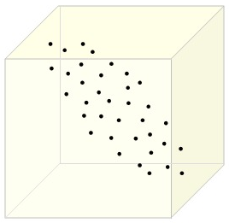
Principal Component Analysis (PCA)
Represent d-dimensional samples with one-dimensional vectors
e
x_{k}
a_{k}
m

Slide 8
Principal Component Analysis (PCA)
Find the optimal direction of
scatter matrix （散布矩阵）

Slide 9
Principal Component Analysis (PCA)
Maximize by e that minimize
Lagrangian multiplier method (s.t. )
Conclusion: e is the eigenvector corresponding to the maximum eigenvalue of the scatter matrix
is the eigenvalue of S (本征值)
e is the eigenvector of S (本征向量)
The maximum eigenvalue corresponds
to the maximum value of

Slide 10
Principal Component Analysis (PCA)
Extending one-dimensional into -dimensional space
Represent by
Minimize squared error

Slide 11
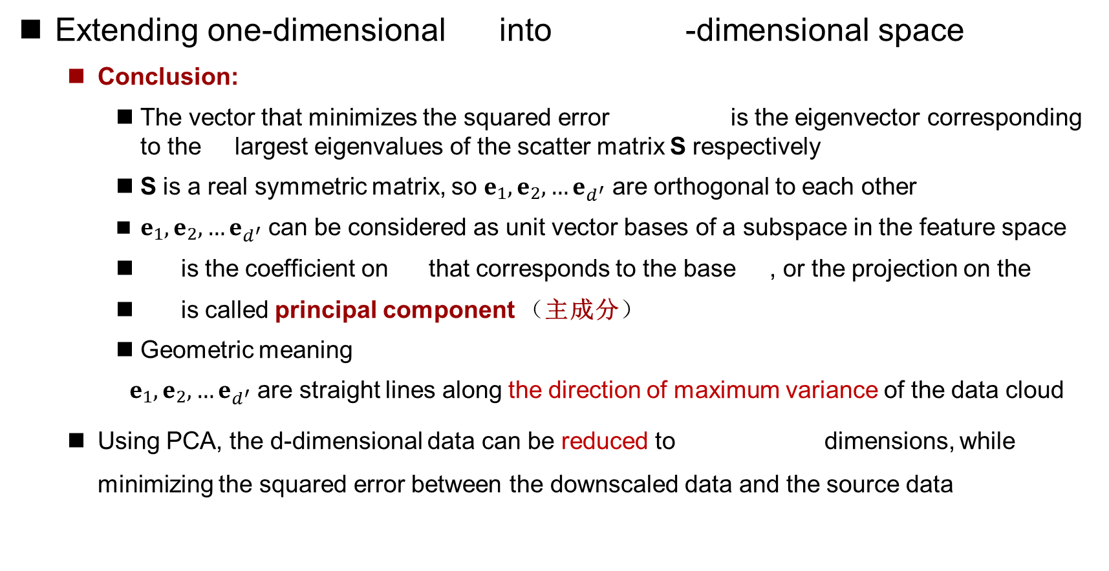
Principal Component Analysis (PCA)
Extending one-dimensional into -dimensional space
Conclusion:
The vector that minimizes the squared error is the eigenvector corresponding to the largest eigenvalues of the scatter matrix S respectively
S is a real symmetric matrix, so $e_{1},e_{2},…e_{d^{′}}$ are orthogonal to each other
$e_{1},e_{2},…e_{d^{′}}$ can be considered as unit vector bases of a subspace in the feature space
is the coefficient on that corresponds to the base , or the projection on the
is called principal component （主成分）
Geometric meaning
$e_{1},e_{2},…e_{d^{′}}$ are straight lines along the direction of maximum variance of the data cloud
Using PCA, the d-dimensional data can be reduced to dimensions, while minimizing the squared error between the downscaled data and the source data
Notes:
e_k称为第k个PC的负荷loading

Slide 12
Principal Component Analysis (PCA)
Principal component analysis steps (d-dimensions is reduced to -dimensions)
Calculate the scatter matrix S
Calculate the eigenvalue of S and the eigenvector
Sort the eigenvectors by their corresponding eigenvalues from the maximum to the minimum
The maximum d ' eigenvectors are selected as projection vectors
, to form projection matrix W, in which the i-th column is
For an arbitrary d-dimensional sample x, its d ' dimensional vector after dimensionality reduction by PCA is

Slide 13
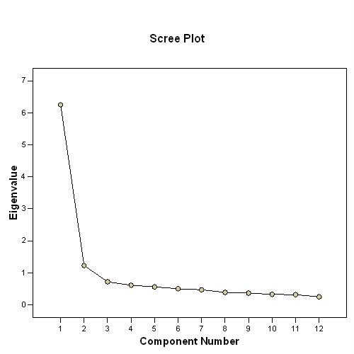
Principal Component Analysis (PCA)
In general, the several maximum eigenvalues account for most of the sum of all eigenvalues
A few eigenvectors corresponding to the largest eigenvalues can represent the vast majority of the information in the original data, while the remaining small part (i.e. the information represented by the eigenvectors corresponding to the smaller eigenvalues) can generally be considered as data noise and lost

Slide 14
Principal Component Analysis (PCA)

Slide 15
Principal Component Analysis (PCA)
Dataset：Iris
Original dimensionality ：4
Notes:
UCI数据集

Slide 16
Principal Component Analysis (PCA)
Reduce to 2-dimensions by PCA
Reduce to 3-dimensions by PCA

Slide 17
Singular Value Decomposition (SVD)
The eigenvalue decomposition of the scatter matrix in PCA is computationally large, and it is very difficult to directly decompose the eigenvalue of if the eigenvector dimension is high
For example, PCA analysis of images:
Image：
Scatter matrix：
matrix eigenvalue decomposition ?
Space complexity and time
complexity are unacceptable!

Slide 18
Singular Value Decomposition (SVD)
Instead of performing an eigenvalue decomposition on S directly, use SVD to perform an eigenvalue decomposition on a smaller matrix
SVD theorem
Let A be a matrix of rank n, then there are two orthogonal matrices
and diagonal matrix
satisfy where is the non-zero eigenvalue of matrix and , and are respectively the eigenvectors of and corresponding to . This decomposition is called the singular value decomposition (SVD) of matrix A， is the singular value of A

Slide 19
Singular Value Decomposition (SVD)
Inference
Use SVD to simplify the eigenvalue decomposition of S
Scatter matrix
where
Let If , then the eigenvalue decomposition for R is faster than the eigenvalue decomposition for S
For example, for most image training sets, the number of pixels in the image is much larger than the number of samples in the training set, i.e.

Slide 20
Singular Value Decomposition (SVD)
Perform the eigenvalue decomposition for R
eigenvalue ：
eigenvector：
According to , the eigenvector of is
The eigenvalue decom-position of matrix
The eigenvalue decom-position of matrix

Slide 21
Fisher Linear Discriminant Analysis
The PCA method looks for the principal axises used to represent the data efficiently (in the sense of least square error)
Linear discriminant analysis (LDA) looks for directions that can be used to effectively classify

Slide 22
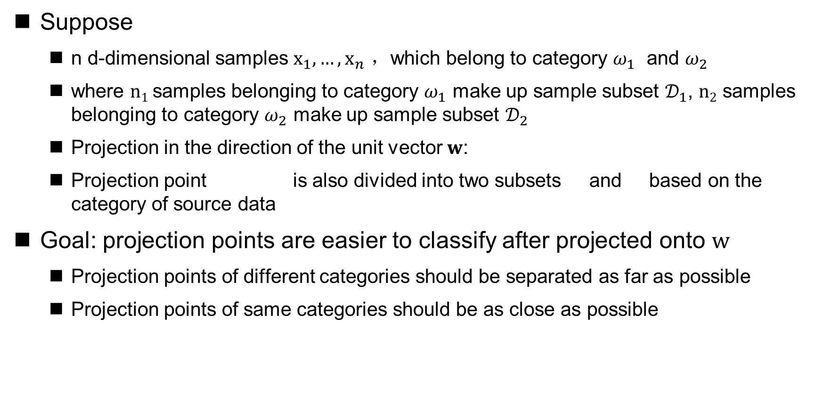
Fisher Linear Discriminant Analysis
Suppose
n d-dimensional samples $x_{1},…,x_{n}$ ，which belong to category $ω_{1}$ and $ω_{2}$
where $n1$samples belonging to category $ω_{1}$ make up sample subset $𝒟_{1}$, $n2$ samples belonging to category $ω_{2}$ make up sample subset $𝒟_{2}$
Projection in the direction of the unit vector $w$:
Projection point is also divided into two subsets and based on the category of source data
Goal: projection points are easier to classify after projected onto $w$
Projection points of different categories should be separated as far as possible
Projection points of same categories should be as close as possible

Slide 23
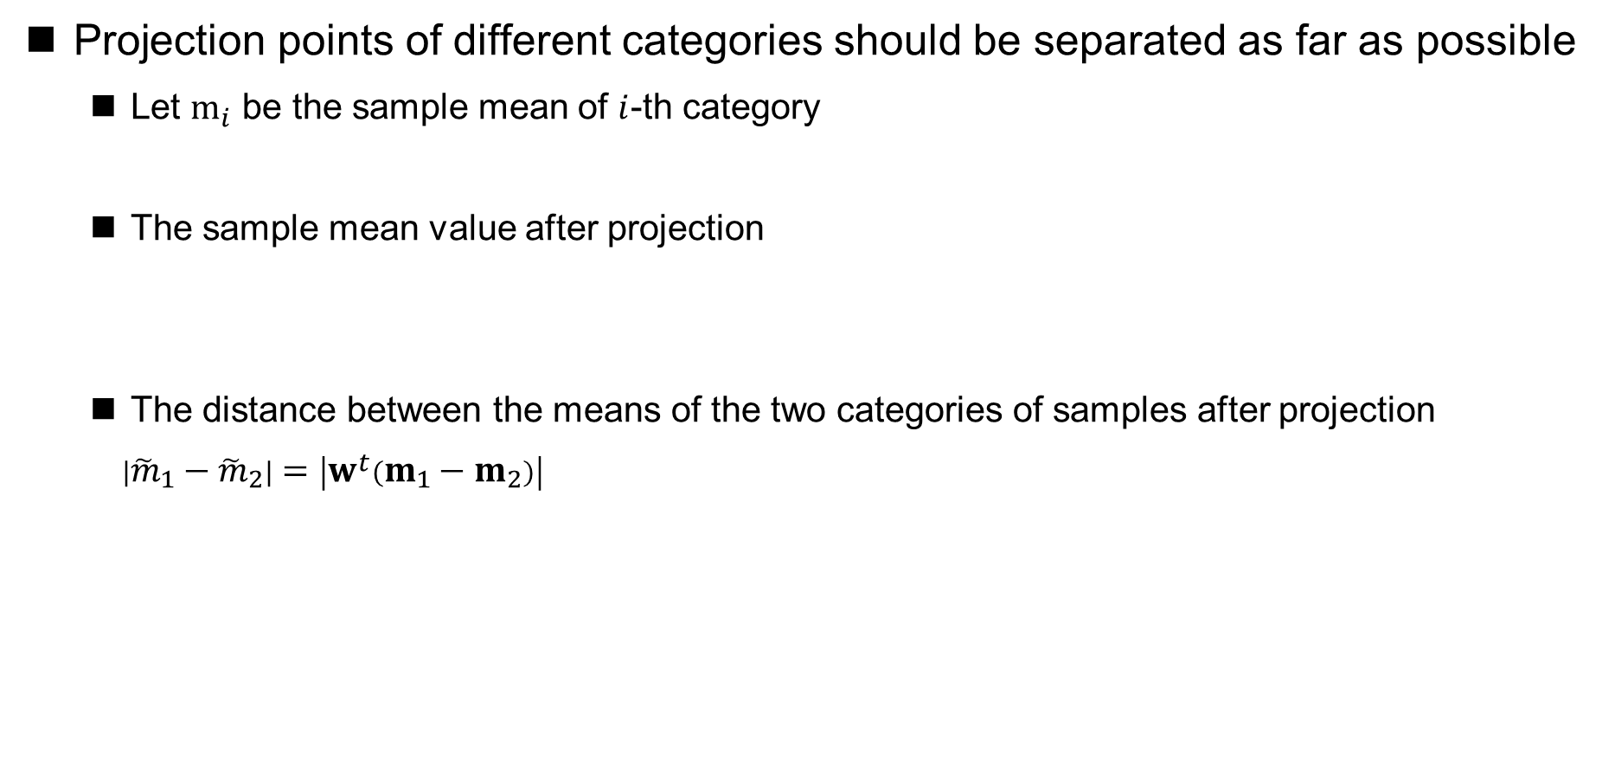
Fisher Linear Discriminant Analysis
Projection points of different categories should be separated as far as possible
Let $m_{i}$ be the sample mean of $i$-th category
The sample mean value after projection
The distance between the means of the two categories of samples after projection
$\left|{\tilde{m}}_{1}−{\tilde{m}}_{2}\right|=\left|w^{t}\left(m_{1}−m_{2}\right)\right|$
The greater this distance, the more separated the two categories of projection points are

Slide 24
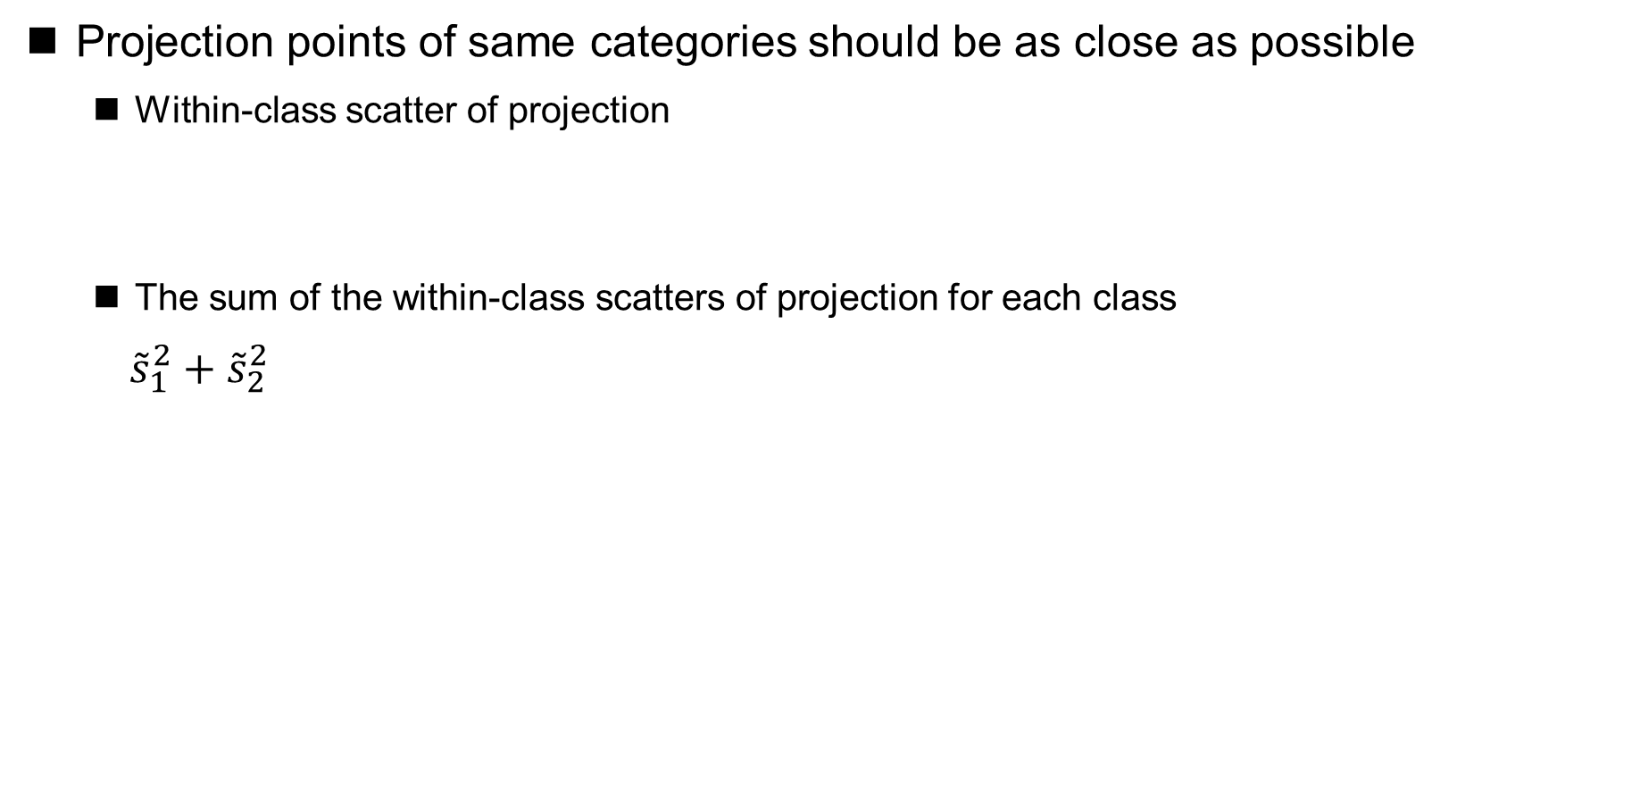
Fisher Linear Discriminant Analysis
Projection points of same categories should be as close as possible
Within-class scatter of projection
The sum of the within-class scatters of projection for each class
${\tilde{s}}_{1}^{2}+{\tilde{s}}_{2}^{2}$
This total within-class scatter reflects the "tightness" of the classes behind the projection, the smaller it is, the closer the projection points are to each other within the same class

Slide 25
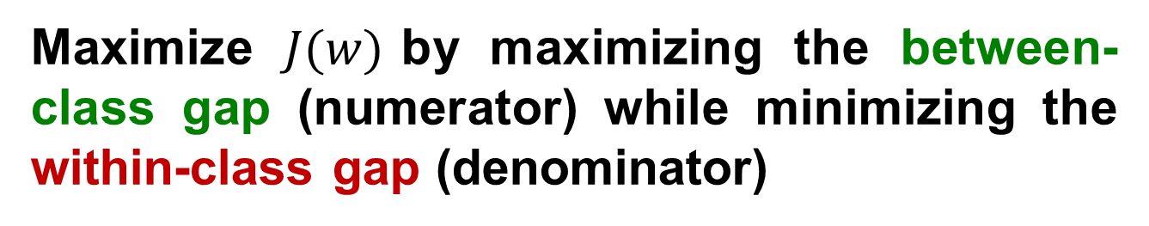
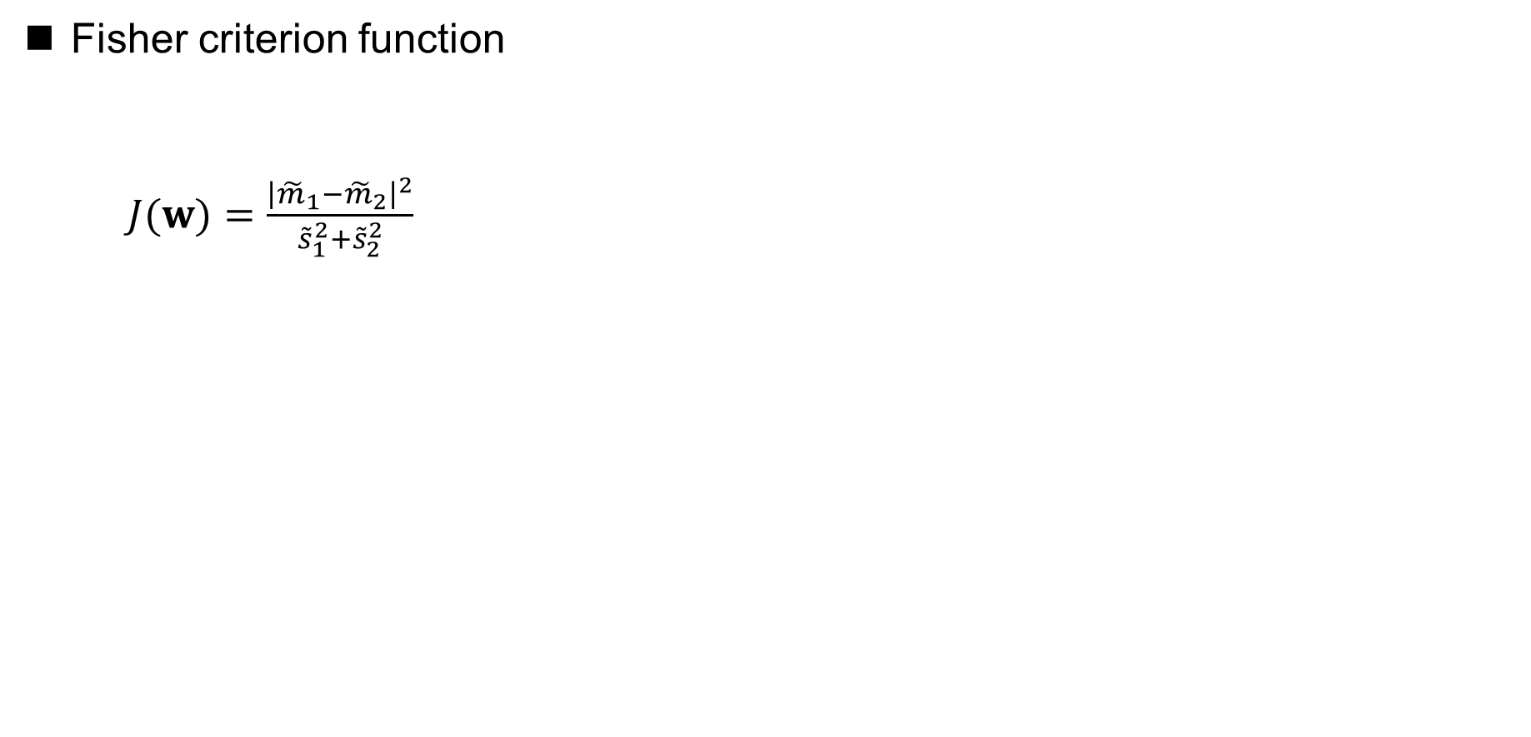
Fisher Linear Discriminant Analysis
Fisher criterion function
$J(w)=\frac{{\left|{\tilde{m}}_{1}−{\tilde{m}}_{2}\right|}^{2}}{{\tilde{s}}_{1}^{2}+{\tilde{s}}_{2}^{2}}$
The distance between the two categories of sample means
Total within-class scatter
Maximize $J(w)$by maximizing the between-class gap (numerator) while minimizing the within-class gap (denominator)

Slide 26
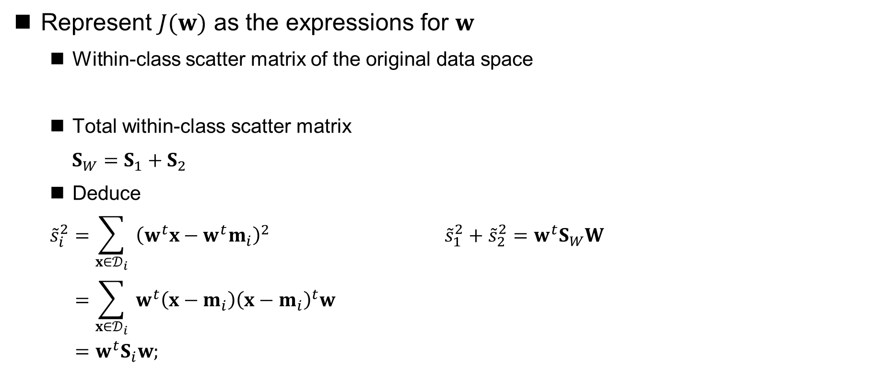
Fisher Linear Discriminant Analysis
Represent $J(w)$ as the expressions for $w$
Within-class scatter matrix of the original data space
Total within-class scatter matrix
$S_{W}=S_{1}+S_{2}$
Deduce
$$\begin{aligned}{\tilde{s}}_{i}^{2}&=\sum_{x∈𝒟_{i}}{ }{\left(w^{t}x−w^{t}m_{i}\right)}^{2} {\tilde{s}}_{1}^{2}+{\tilde{s}}_{2}^{2}=w^{t}S_{W}W \\ &=\sum_{x∈𝒟_{i}}{ }w^{t}\left(x−m_{i}\right){\left(x−m_{i}\right)}^{t}w \\ &=w^{t}S_{i}w;\end{aligned}$$

Slide 27
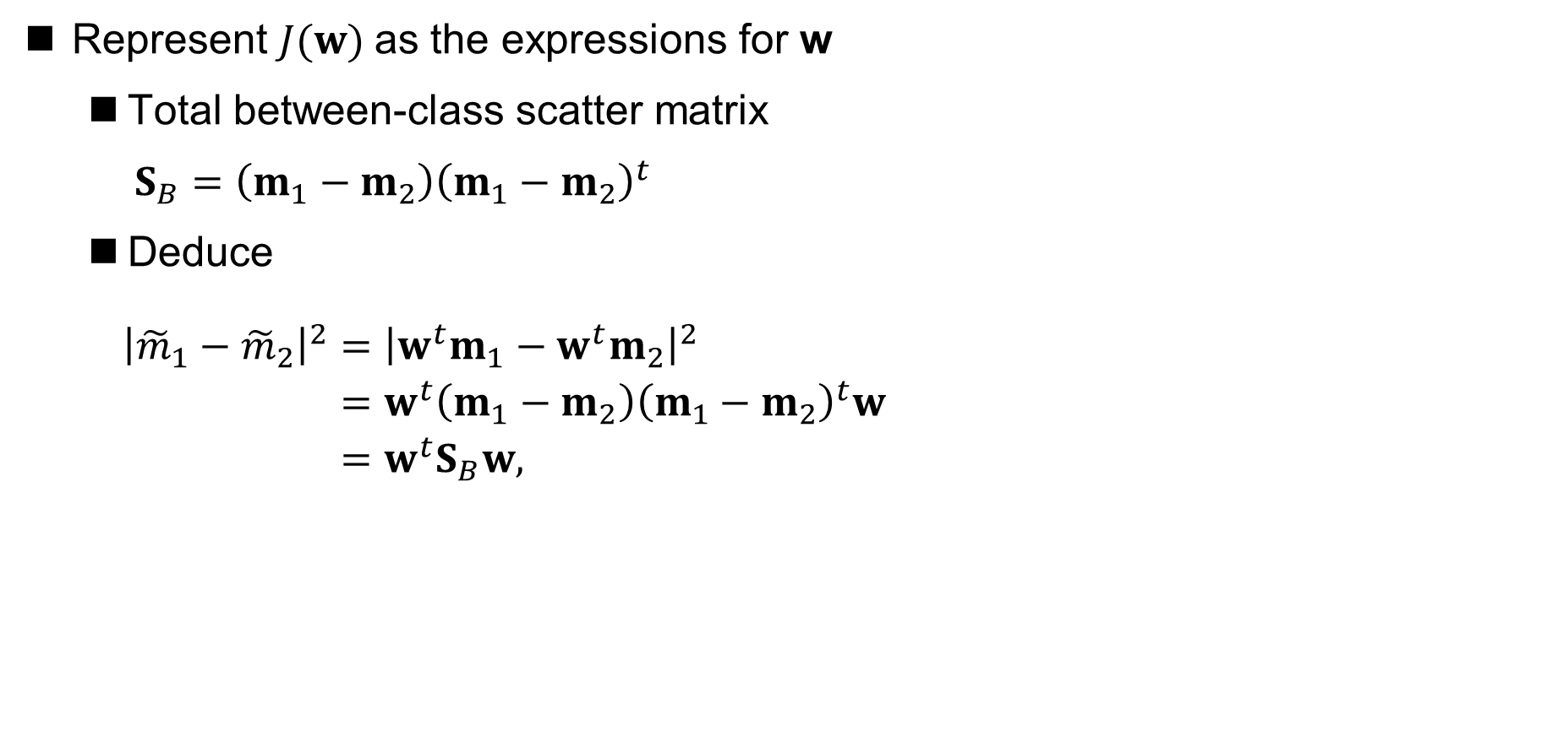
Fisher Linear Discriminant Analysis
Represent $J(w)$as the expressions for w
Total between-class scatter matrix
$S_{B}=\left(m_{1}−m_{2}\right){\left(m_{1}−m_{2}\right)}^{t}$
Deduce
$\begin{aligned}{\left|{\tilde{m}}_{1}−{\tilde{m}}_{2}\right|}^{2}&={\left|w^{t}m_{1}−w^{t}m_{2}\right|}^{2} \\ &=w^{t}\left(m_{1}−m_{2}\right){\left(m_{1}−m_{2}\right)}^{t}w \\ &=w^{t}S_{B}w,\end{aligned}$

Slide 28
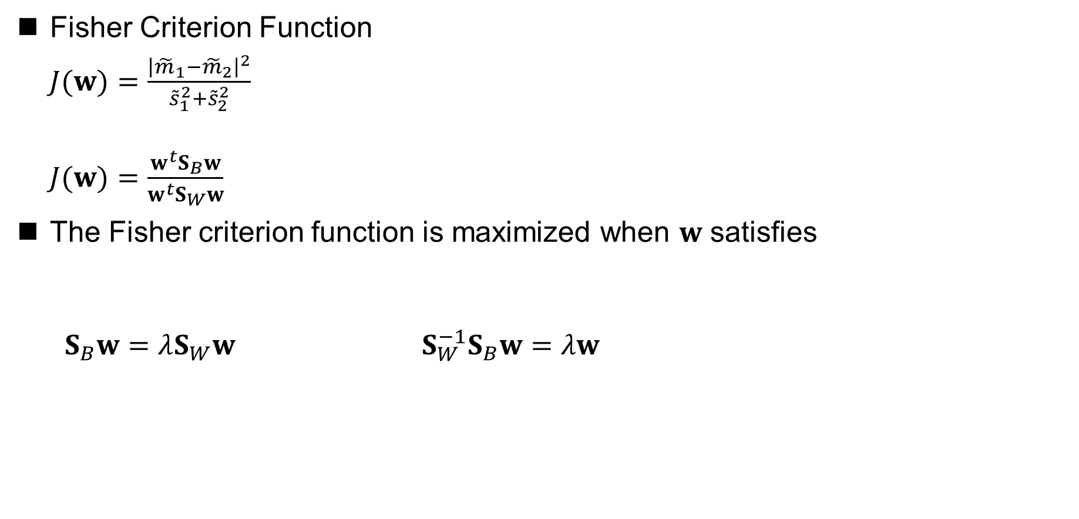

Fisher Linear Discriminant Analysis
Fisher Criterion Function
$J(w)=\frac{{\left|{\tilde{m}}_{1}−{\tilde{m}}_{2}\right|}^{2}}{{\tilde{s}}_{1}^{2}+{\tilde{s}}_{2}^{2}}$
$J(w)=\frac{w^{t}S_{B}w}{w^{t}S_{W}w}$
The Fisher criterion function is maximized when $w$ satisfies
$S_{B}w=λS_{W}w$ $S_{W}^{−1}S_{B}w=λw$
$Sw$ is non-singular
Generalized eigenvalue problems
Conventional eigenvalue problems

Slide 29
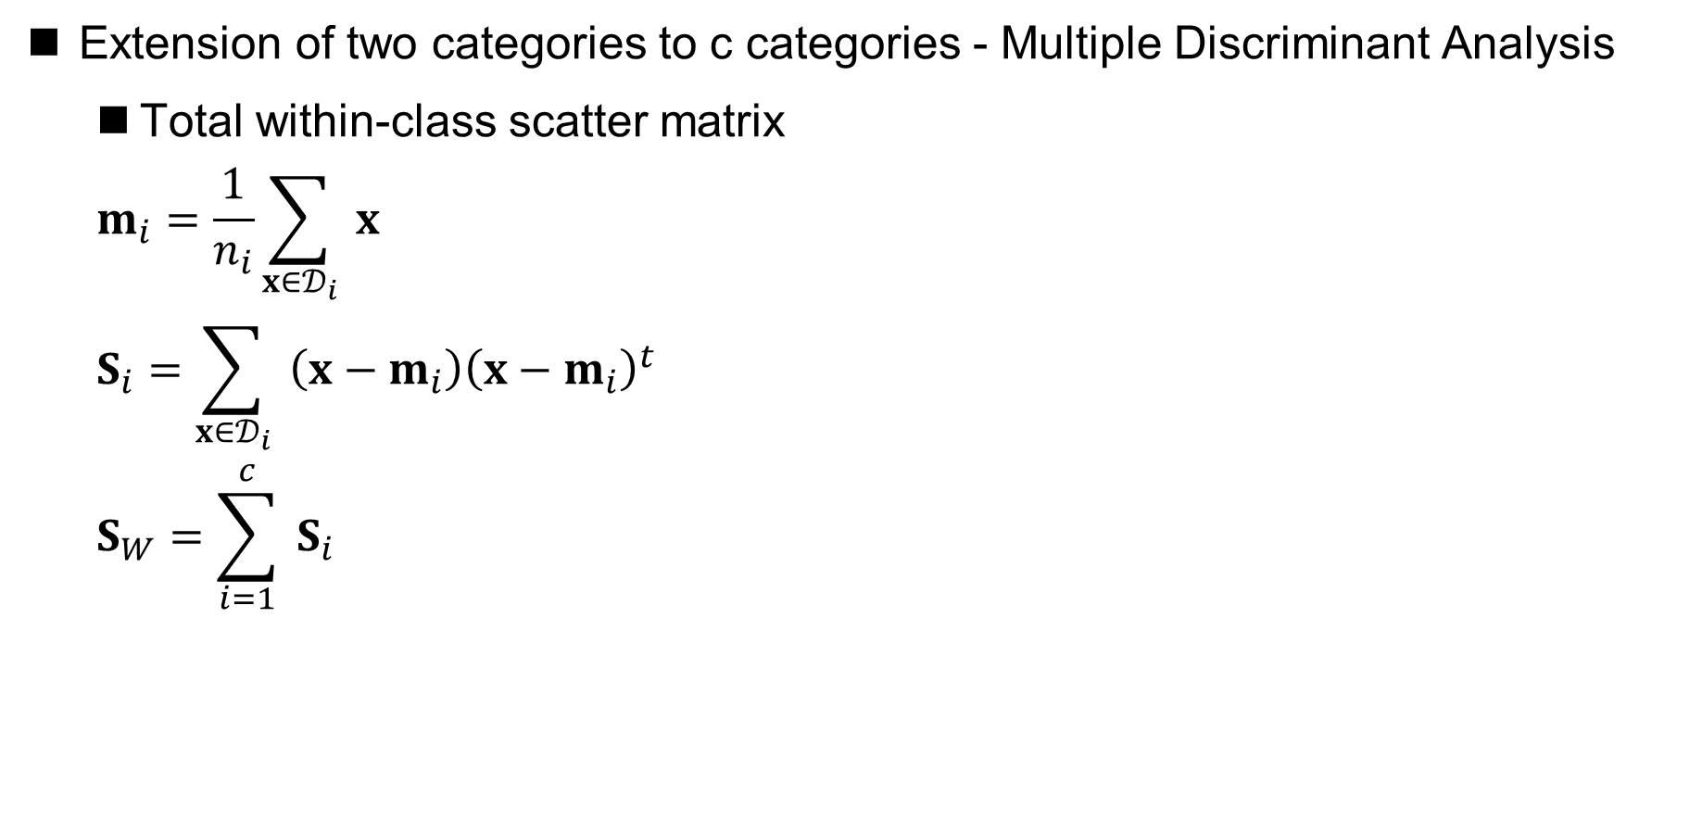
Fisher Linear Discriminant Analysis
Extension of two categories to c categories - Multiple Discriminant Analysis
Total within-class scatter matrix
$$\begin{aligned}&m_{i}=\frac{1}{n_{i}}\sum_{x∈𝒟_{i}}{ }x \\ &S_{i}=\sum_{x∈𝒟_{i}}{ }\left(x−m_{i}\right){\left(x−m_{i}\right)}^{t} \\ &S_{W}=\sum_{i=1}^{c}{ }S_{i}\end{aligned}$$

Slide 30
Fisher Linear Discriminant Analysis
Extension of two categories to c categories - Multiple Discriminant Analysis
Total mean vector
Total scatter matrix

Slide 31
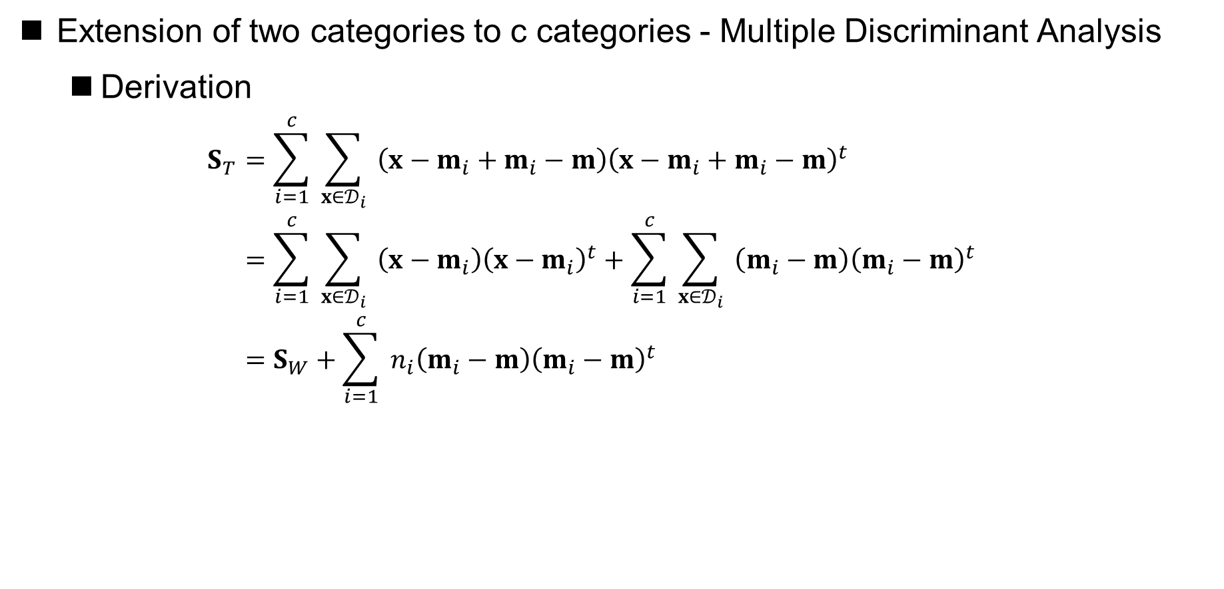
Fisher Linear Discriminant Analysis
Extension of two categories to c categories - Multiple Discriminant Analysis
Derivation
$$\begin{aligned}S_{T}&=\sum_{i=1}^{c}{ }\sum_{x∈𝒟_{i}}{ }\left(x−m_{i}+m_{i}−m\right){\left(x−m_{i}+m_{i}−m\right)}^{t} \\ &=\sum_{i=1}^{c}{ }\sum_{x∈𝒟_{i}}{ }\left(x−m_{i}\right){\left(x−m_{i}\right)}^{t}+\sum_{i=1}^{c}{ }\sum_{x∈𝒟_{i}}{ }\left(m_{i}−m\right){\left(m_{i}−m\right)}^{t} \\ &=S_{W}+\sum_{i=1}^{c}{ }n_{i}\left(m_{i}−m\right){\left(m_{i}−m\right)}^{t}\end{aligned}$$
between-class scatter matrix

Slide 32
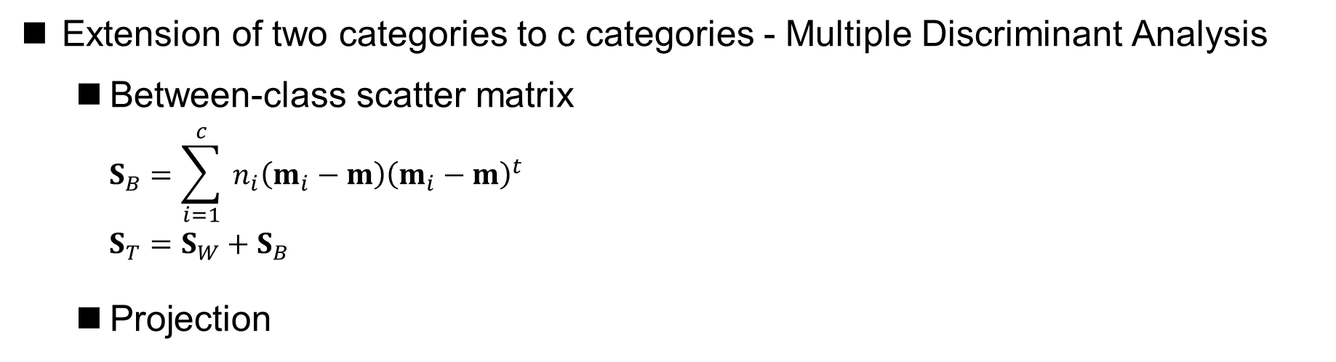
Fisher Linear Discriminant Analysis
Extension of two categories to c categories - Multiple Discriminant Analysis
Between-class scatter matrix
$$\begin{aligned}S_{B}&=\sum_{i=1}^{c}{ }n_{i}\left(m_{i}−m\right){\left(m_{i}−m\right)}^{t} \\ S_{T}&=S_{W}+S_{B}\end{aligned}$$
Projection
Transformation matrix
Projection point
Original sample point

Slide 33
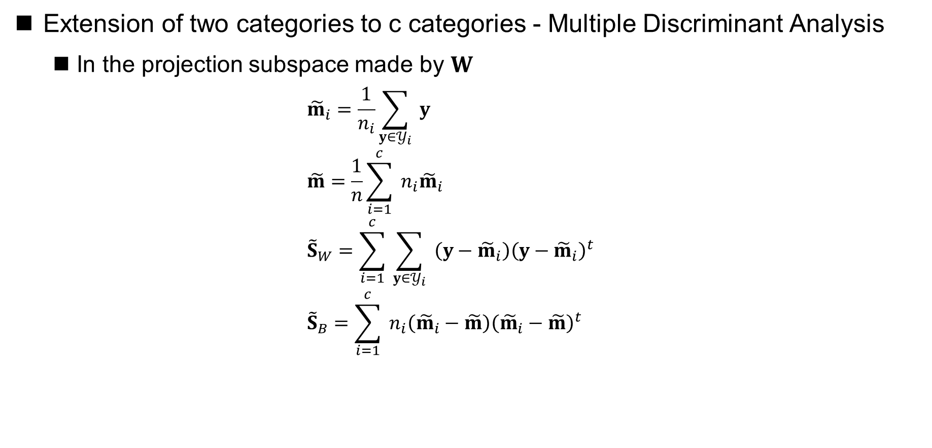
Fisher Linear Discriminant Analysis
Extension of two categories to c categories - Multiple Discriminant Analysis
In the projection subspace made by $W$
$$\begin{aligned}&{\tilde{m}}_{i}=\frac{1}{n_{i}}\sum_{y∈𝒴_{i}}{ }y \\ &\tilde{m}=\frac{1}{n}\sum_{i=1}^{c}{ }n_{i}{\tilde{m}}_{i} \\ &{\tilde{S}}_{W}=\sum_{i=1}^{c}{ }\sum_{y∈𝒴_{i}}{ }\left(y−{\tilde{m}}_{i}\right){\left(y−{\tilde{m}}_{i}\right)}^{t} \\ &{\tilde{S}}_{B}=\sum_{i=1}^{c}{ }n_{i}\left({\tilde{m}}_{i}−\tilde{m}\right){\left({\tilde{m}}_{i}−\tilde{m}\right)}^{t}\end{aligned}$$

Slide 34
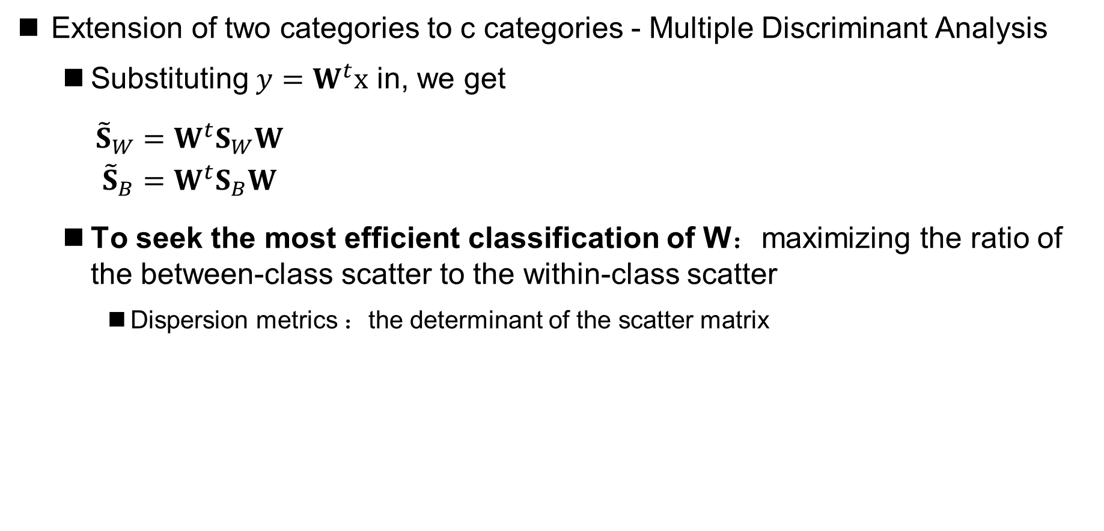
Fisher Linear Discriminant Analysis
Extension of two categories to c categories - Multiple Discriminant Analysis
Substituting $y=W^{t}x$ in, we get
$\begin{aligned}{\tilde{S}}_{W}&=W^{t}S_{W}W \\ {\tilde{S}}_{B}&=W^{t}S_{B}W\end{aligned}$
To seek the most efficient classification of W：maximizing the ratio of the between-class scatter to the within-class scatter
Dispersion metrics ：the determinant of the scatter matrix

Slide 35
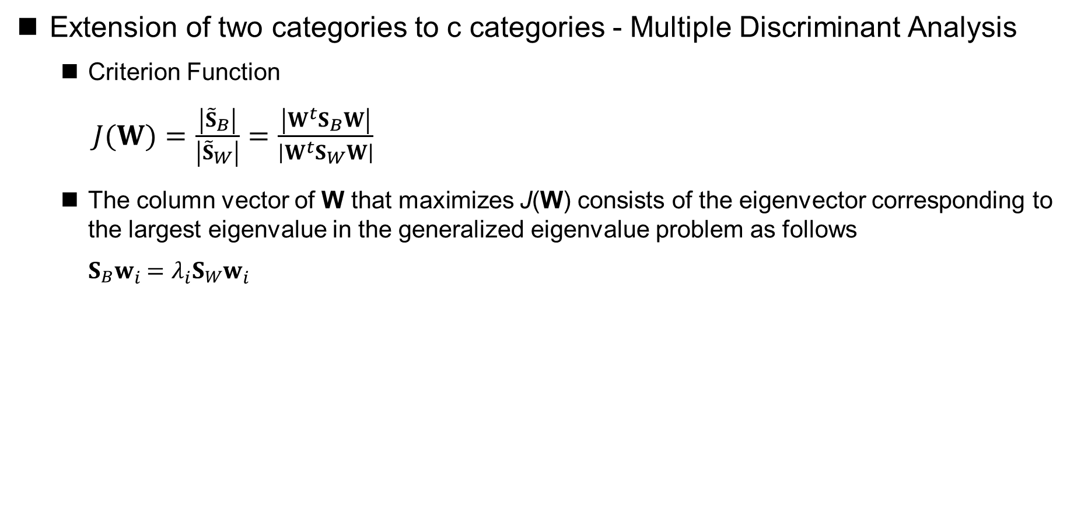
Fisher Linear Discriminant Analysis
Extension of two categories to c categories - Multiple Discriminant Analysis
Criterion Function
$J(W)=\frac{\left|{\tilde{S}}_{B}\right|}{\left|{\tilde{S}}_{W}\right|}=\frac{\left|W^{t}S_{B}W\right|}{\left|W^{t}S_{W}W\right|}$
The column vector of W that maximizes J(W) consists of the eigenvector corresponding to the largest eigenvalue in the generalized eigenvalue problem as follows
$S_{B}w_{i}=λ_{i}S_{W}w_{i}$
S_{B} is the sum of c matrices of rank one or zero, and because only c−1 of these are independent, S_{B} is of rank c−1 or less
Thus, no more than c−1 of the eigenvalues are nonzero, which correspond to c−1 eigenvectors, and the matrix W has at most c-1 columns

Slide 36
Fisher Linear Discriminant Analysis

Slide 37
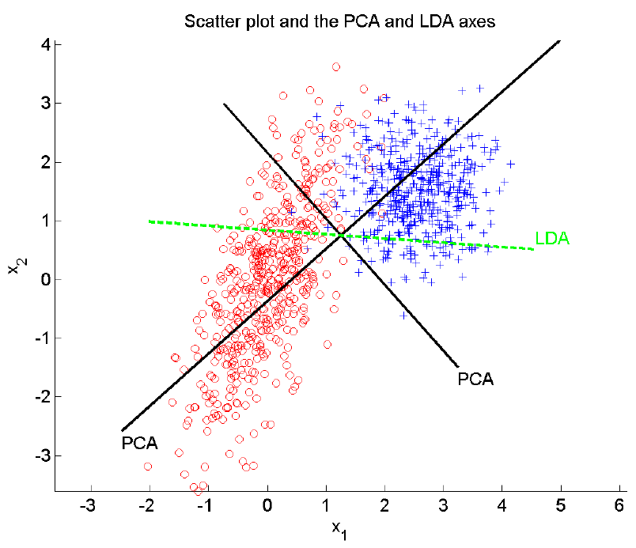
Fisher Linear Discriminant Analysis
Projection to principal component orientation
Projection to LDA orientation

Slide 38
Dimensionality Reduction Example: Satellite Image Analysis
The original satellite image and the first six PCA principal component projection directions

Slide 39
Dimensionality Reduction Example: Satellite Image Analysis
The original satellite image and the first six LDA projection directions

Slide 40
Dimensionality Reduction Example: Satellite Image Analysis
The original satellite image and the first six PCA principal component projection directions

Slide 41
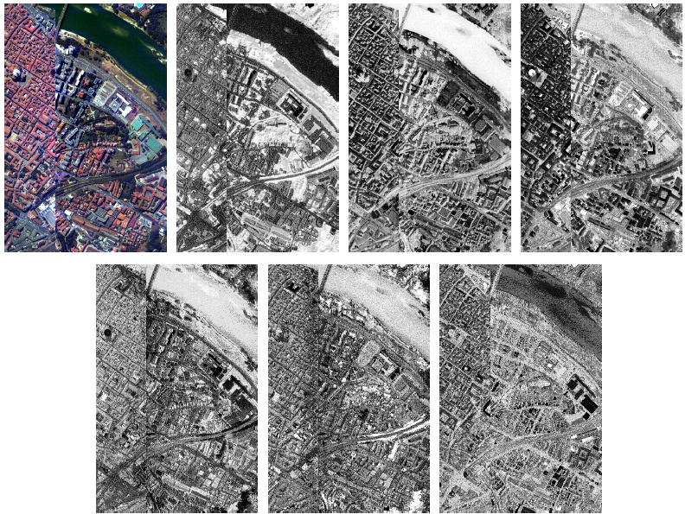
Dimensionality Reduction Example: Satellite Image Analysis
The original satellite image and the first six LDA projection directions

Slide 42
Dimension reduction example: face recognition
Typical face image collection

Slide 43
Dimension reduction example: face recognition
The first 15 PCA principal component projection directions of the face image, also known as “Eigenface“(本征脸)

Slide 44
Summary
Feature combination to reduce dimensionality
Principal component analysis (PCA)
Look for projections to represent data effectively
Unsupervised
Linear discriminant analysis (LDA)
Look for projections to classify data effectively
Supervised
Notes:
16：9的比例整理到这里

Slide 45
Ch 06. Feature Reduction and Selection
Part 2 Feature Selection
Notes:
45

Slide 46
Dimensionality Reduction
The way to Dimensionality Reduction
Feature combination
Combine several features to form a new feature
Feature selection
Select a subset of the existing feature set

Slide 47
Feature Selection
The feature selection method consists of two main components
Search process
Selection criteria
Search process
The process of searching the system in all candidate feature subsets
In principle, exhaustive search （穷尽搜索） can find optimal child sets, In practice，a more efficient non-exhaustive search algorithm is often used to find the suboptimal solution
Selection criteria
Criteria used to determine whether a subset of features is superior to another subset of features
In principle, the selection criterion is the evaluation criterion of system performance, such as classification error rate, etc. In practice, simplified selection criteria are often used

Slide 48
Search Process
Sequential Forward Selection （循序向前选择法，SFS）
First, the optimal individual features are selected
Then, combine all the other features with the first selected feature to form a candidate feature pair to find the optimal pair
The remaining features are then paired with the best features selected in the previous step to form candidate feature triples and find the optimal triples
The process stops until enough features are selected

Slide 49
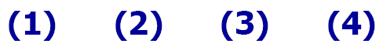
Search Process
Sequential Forward Selection （循序向前选择法，SFS）

Slide 50
Search Process
Sequential Forward Selection （循序向前选择法，SFS）
Disadvantage
The distinguishing force of single feature is poor, but the combined distinguishing force of two features is strong. In this case, SFS fails
When each feature of the optimal subset is considered separately, it is not always optimal

Slide 51
Search Process
SFS：example——Satellite image analysis

Slide 52
Search Process
Sequential Backward Selection （循序向后选择法，SBS）
First, select all d features
Then, an arbitrary one of the features is removed to form the d-1 feature set with d candidates, and the best one is selected
Then remove an arbitrary feature from the D-1 feature set obtained in the previous step to form d-1 d-2 feature sets, and select the best one
The process stops when the number of features in the feature set reaches a predetermined value

Slide 53
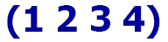
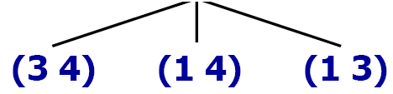
Search Process
Sequential Backward Selection （循序向后选择法，SBS）
Because the number of features considered by SBS is greater than or equal to the expected number of features, SBS usually requires more selection criteria calculation than SFS

Slide 54
Search Process
SBS：example——Satellite image analysis

Slide 55
Search Process
Other search processes
Single optimal subset of features
Search directly for the optimal individual features (one feature at a time, compute the selection criteria) and use the set of them as the result of the feature selection
Simple, but often unreliable
The optimal feature subset can be found only if the features are completely independent of each other
…

Slide 56
Selection Criteria
Ideal method
Represent the training sample with the selected feature subset, train the classifier, and then test the generalization error of the classifier (e.g., cross-validation).
for each feature subset, we need to train a classifier, so the computation is very large
Simplified method
Define a within-class distance metric to describe class separability when a subset of features is adopted
There is no need to train a classifier for each feature subset, so the computation is small

Slide 57
Selection Criteria
Within-class distance
within-class scatter

Slide 58
Selection Criteria
Within-class distance
mean square distance

